Slide 1
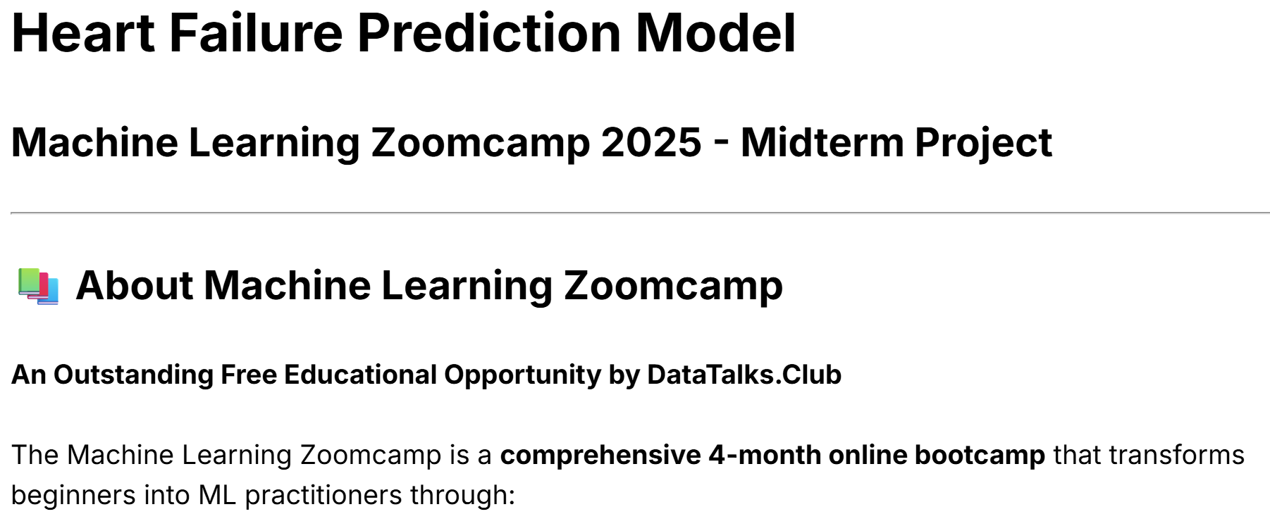
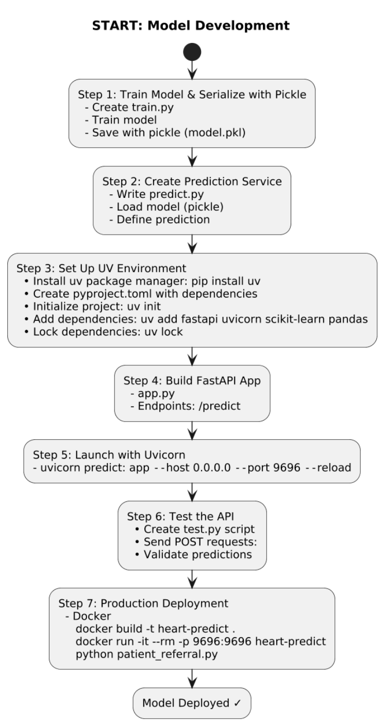
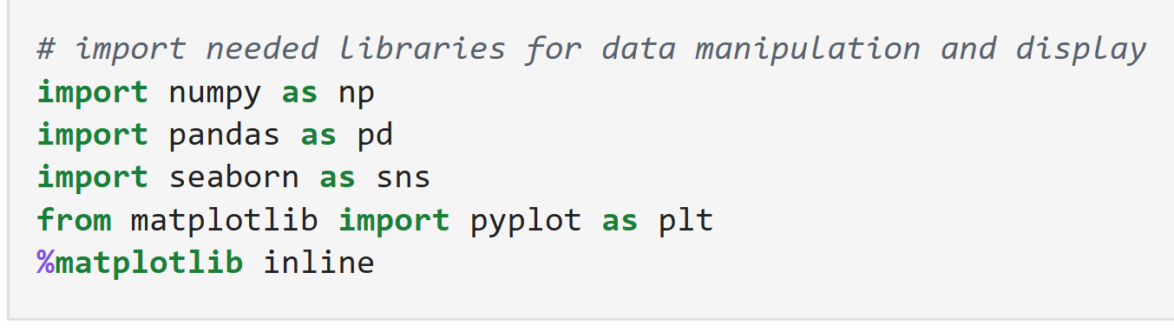
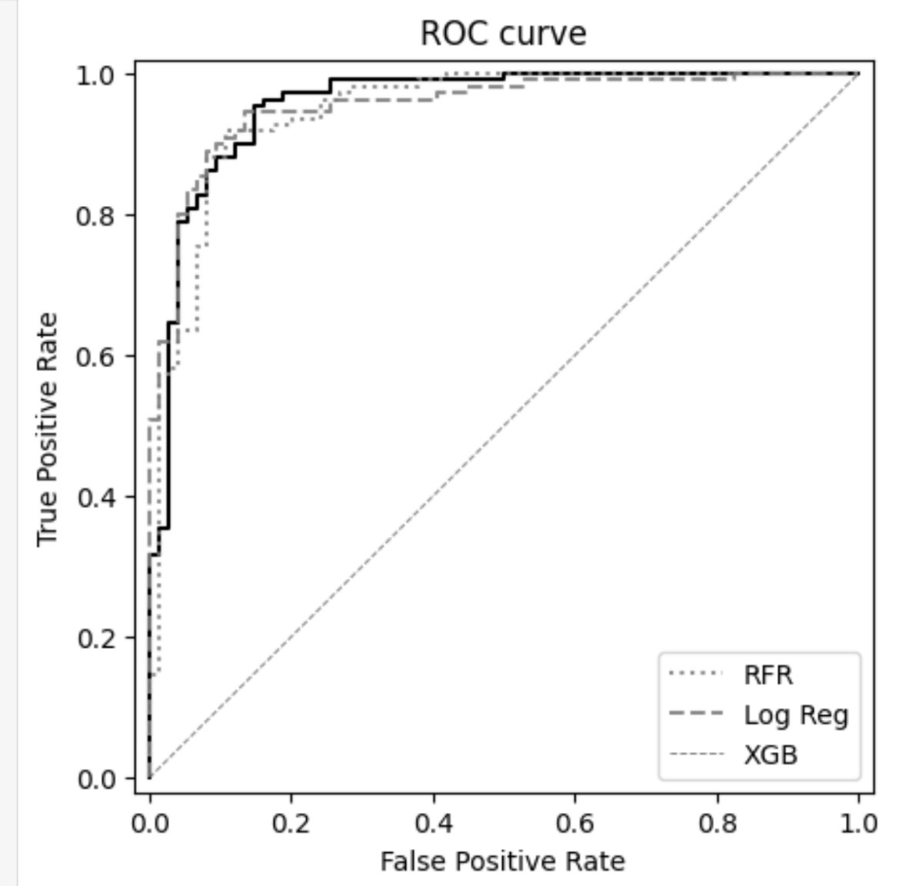

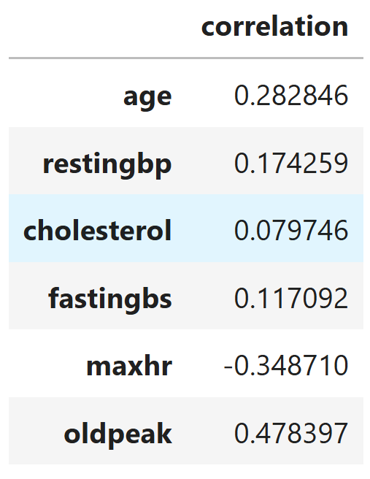
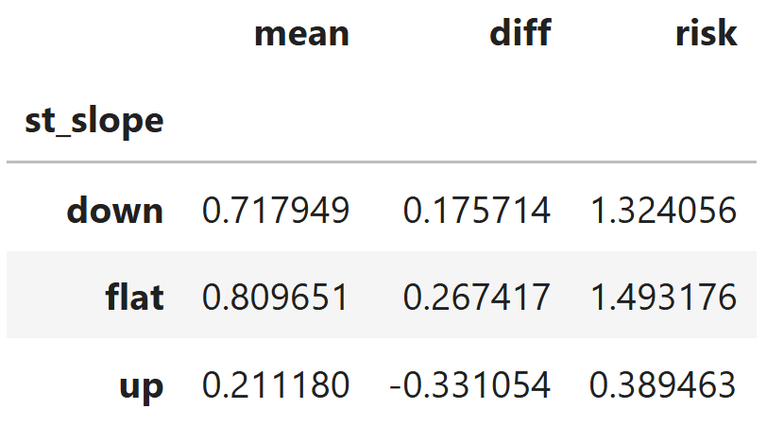
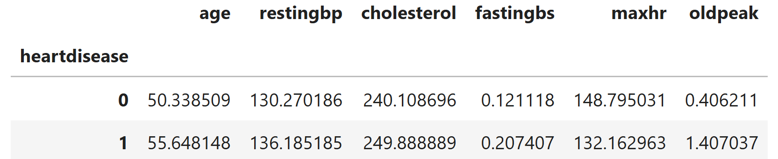
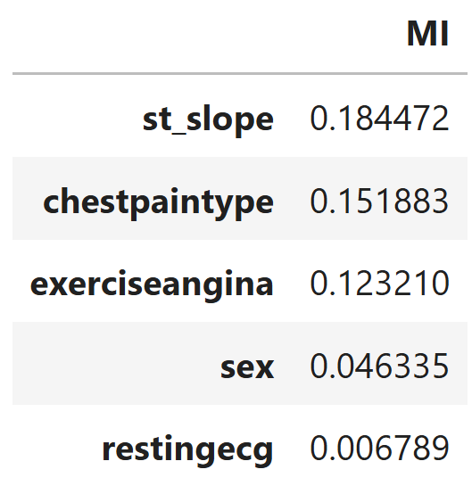
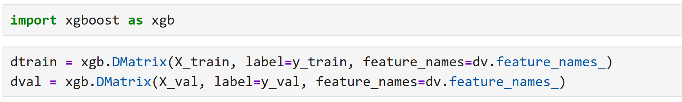
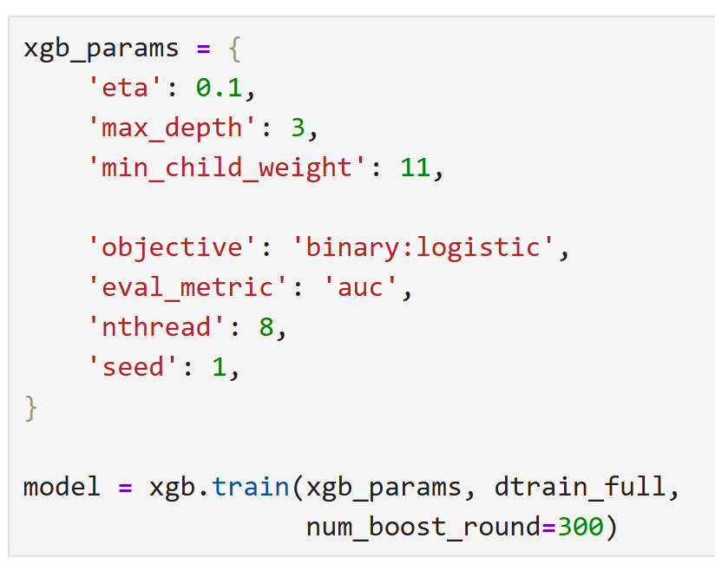
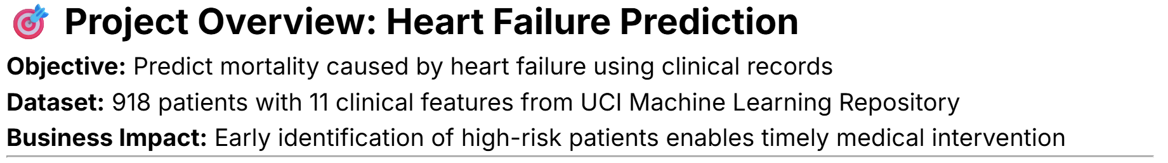
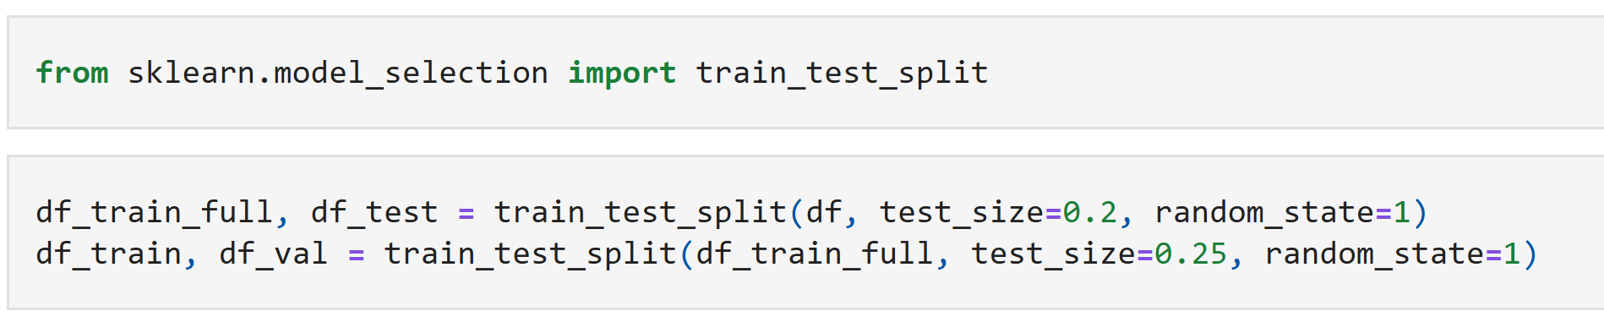
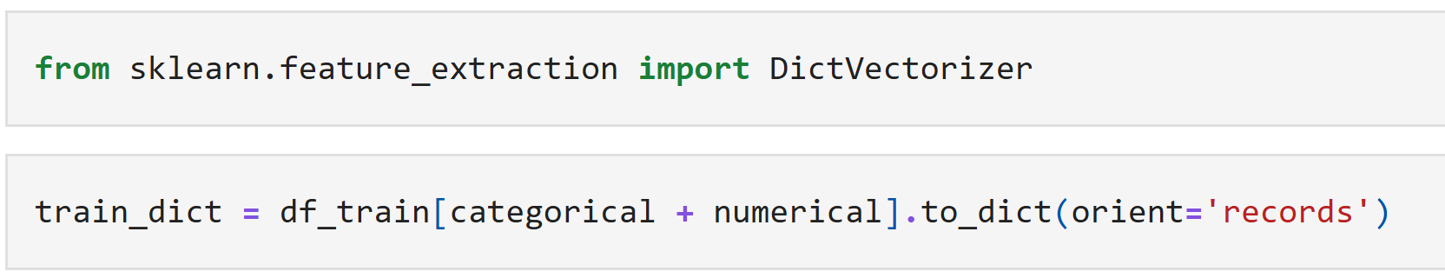
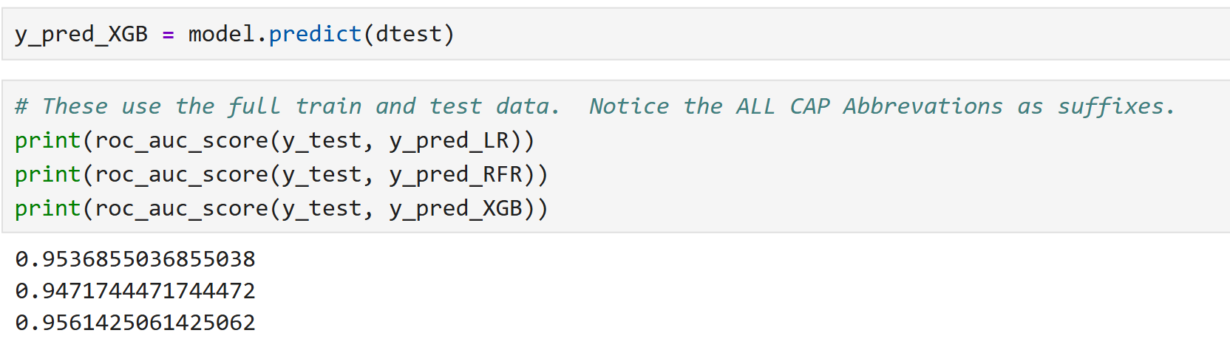
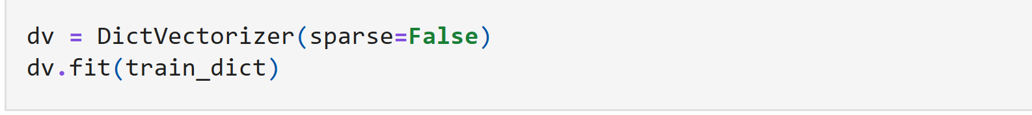
Machine Learning Model for Heart Disease Prediction as a Web Service On Cloud
By Dr. Jared Gavin
University of Arkansas – Monticello: School of Mathematical and Natural Sciences
Special thanks to Alexey Grigorev, the DataTalksClub and Federico Soriano Palacios [1]
📓 Jupyter Notebook Summary:
EDA, Train/Test Split and Dictionary Vectorizer
Logistic Regression, Random Forrest Regression and XGBoost models where trained and compared using accuracy_score and roc_auc_score from scikit-learn. XGBoost is an open-source, highly optimized machine learning library that uses gradient boosting to solve classification and regression problems. The XGBoost model produced an roc_auc_score of 0.925 using the full train and test data sets.
Receiver Operating Characteristic:
A ROC curve is a graphical tool used to evaluate the performance of binary classification models across all possible classification thresholds. It visualizes the trade-off between correctly identifying positive cases and incorrectly classifying negative cases as positive.
“Cardiovascular diseases (CVDs) are the number 1 cause of death globally, taking an estimated 17.9 million lives each year, which accounts for 31% of all deaths worldwide. Four out of 5 CVD deaths are due to heart attacks and strokes, and one-third of these deaths occur prematurely in people under 70 years of age. Heart failure is a common event caused by CVDs, and this dataset contains 11 features that can be used to predict possible heart disease.
People with cardiovascular disease or who are at high cardiovascular risk (due to the presence of one or more risk factors such as hypertension, diabetes, hyperlipidemia or already established disease) need early detection and management, wherein a machine learning model can be of great help.” [1]
Shown above are the correlation, risk, mean values of heart disease groups and mutual information scores for the features calculated during the exploratory data analysis of the project. Top Left: Age, old peak and resting blood pressure have high positive correlation with heart disease. Top Right: Shows a high risk value for flat and down slopes. ST slope indicates how the ST segment depresses for every beat per minute increase in heart rate during a stress test. Middle: Mean values for numerical features of patients that indicate heart disease and patients that don’t. Left: ST slope, chest pain type, and exercise angina have the highest mutual information scores.
The XGBoost model was tuned by finding the highest roc_auc score while adjusting learning rate, max tree depth, and the minimum child weight. The parameters to the left were chosen as the optimal model. Following parameter tuning, k-fold cross validation was performed using 10 splits.
Features description - Categorical or Numerical [units or classification]
Age Age of the patient - Numerical [years]
Sex Sex of the patient - Categorical [M: Male, F: Female]
ChestPainType Chest pain type -
Categorical [TA: Typical Angina, ATA: Atypical Angina, NAP: Non-Anginal Pain, ASY: Asymptomatic]
RestingBP Resting blood pressure - Numerical [mm Hg]
Cholesterol Serum cholesterol - Numerical [mm/dl]
FastingBS Fasting blood sugar - Binary [1: if > 120 mg/dl, 0: otherwise]
RestingECG Resting electrocardiogram results -
Categorical [Normal, ST: ST-T wave abnormality, LVH: left ventricular hypertrophy]
MaxHR Maximum heart rate achieved - Numerical [60-202]
ExerciseAngina Exercise-induced angina - Binary [Y: Yes, N: No]
Oldpeak ST depression - Numerical [measured in depression]
ST_Slope Slope of peak exercise ST segment - Categorical [Up: upsloping, Flat: flat, Down: downsloping]
Target
HeartDisease Binary [1: heart disease, 0: Normal]
Model Scores
Below are the final roc_auc scores for all 3 models ran using the full training and test data set.
The heartpredict app was launched on cloud using a website called Fly.io. To use the app, simply go to https://heartpredict.fly.dev/docs and select “try it out” under the POST heading. A default “patient” is already included under the “request body.’ Clicking on the “Execute” button will return a response based on the patient data. Under “Server response,” a probability and heart_failure prediction is returned in json format. The limits of the patient features can be found in the predict.py “Patient” class in the github repository: https://github.com/jg5xraydelta/MLZmidterm_project2025/tree/main.

